Slide 1


The Role of Artificial Intelligence Driven 5G Networks in
COVID-19 Outbreak: Opportunities, Challenges, and Future Outlook
Attai Ibrahim Abubakar, Kenechi G. Omeke, Metin Ozturk,
Sajjad Hussain and Muhammad Ali Imran
2020
Sertay Akpınar

Slide 2

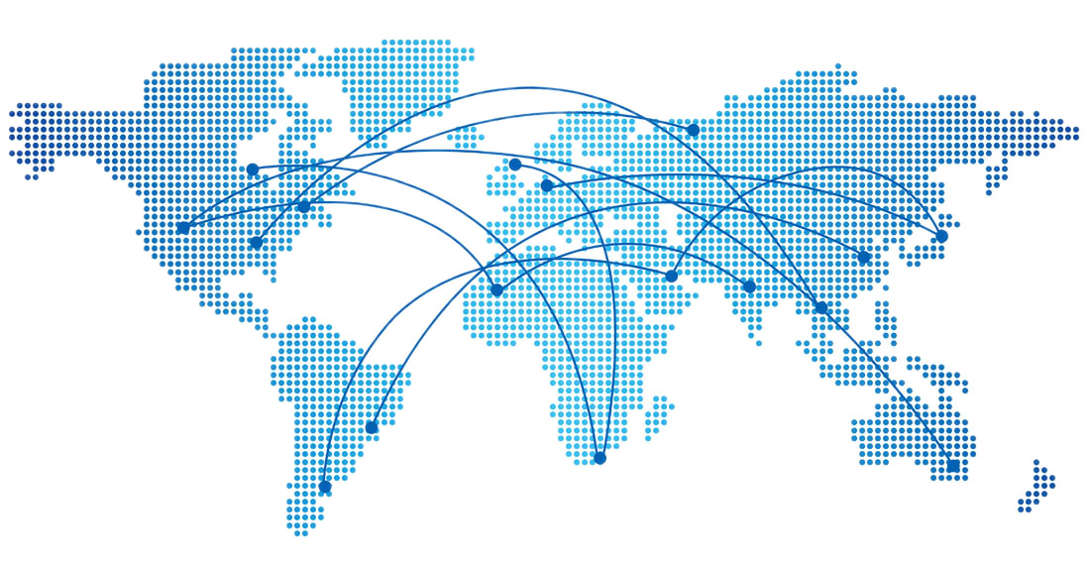

Introduction
1/5
Because of the global pandemic, many individuals have had to rely on telecommunications in order to prevent complete shutdown of their operations.
This has put enormous pressure on both fixed and mobile networks.
The Role of Artificial Intelligence Driven 5G Networks in COVID-19 Outbreak
Sertay Akpınar

Slide 3
2/5
The Role of Artificial Intelligence Driven 5G Networks in COVID-19 Outbreak
Sertay Akpınar

Slide 4
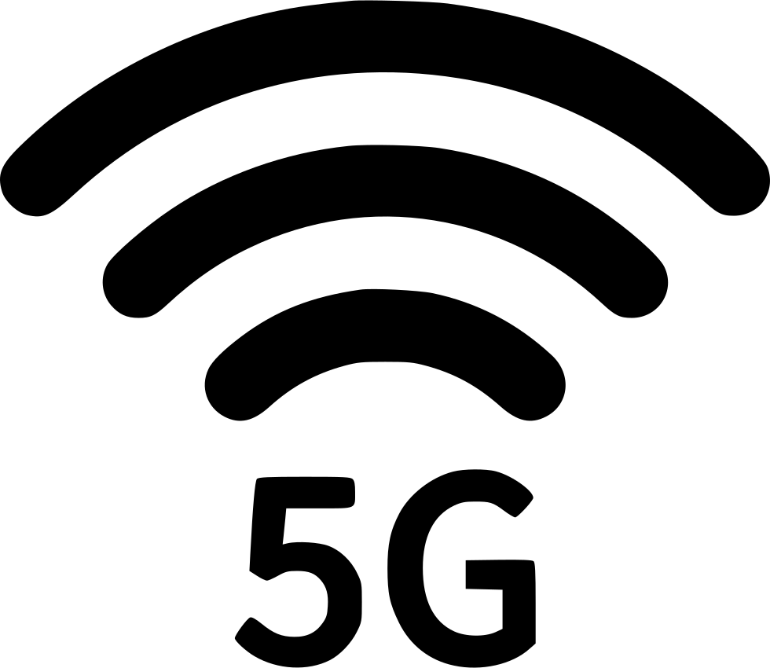
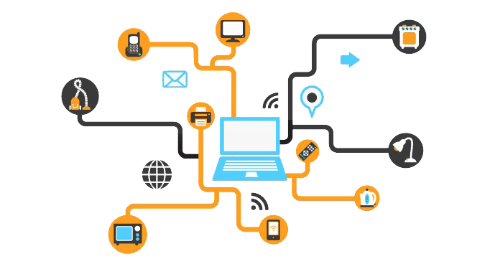
HOWEVER,
3/5
Self-organizing networks and artificial intelligence have been implemented in 5G networks.
Means,
INTELLIGENT NETWORK
AUTONOMOUS NETWORK
The Role of Artificial Intelligence Driven 5G Networks in COVID-19 Outbreak
Sertay Akpınar

Slide 5
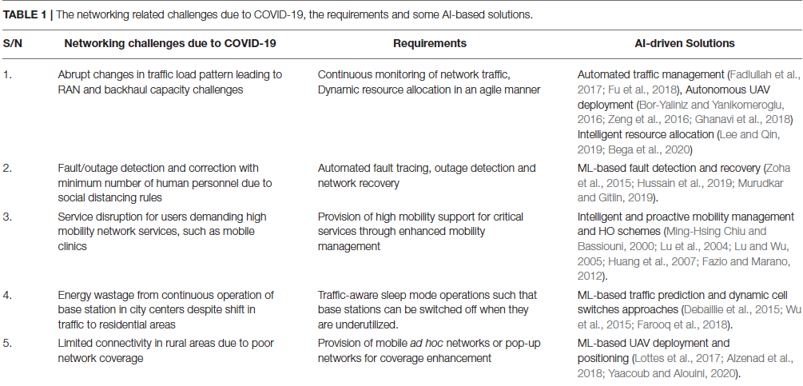
4/5
The Role of Artificial Intelligence Driven 5G Networks in COVID-19 Outbreak
Sertay Akpınar

Slide 6

5/5
In this presentation, I focused on the networking related challenges which can be addressed by using AI in 5G.
The Role of Artificial Intelligence Driven 5G Networks in COVID-19 Outbreak
Sertay Akpınar

Slide 7
THANKS FOR LISTENING ☺

